Slide 1
Hiring Process Analytics

Slide 2
Project Description
Hiring process is the fundamental and the most important function of a company. Here, the MNCs get to know about the major underlying trends about the hiring process. Trends such as- number of rejections, number of interviews, types of jobs, vacancies etc. are important for a company to analyze before hiring freshers or any other individual.

Slide 3
Approach
Downloading the attached dataset
Understanding the dataset
Identifying any missing values within dataset
Checking & Removing outliers
Performing EDA
Doing analysis as per the requirement

Slide 4
Tech stack used
Microsoft Excel : For performing analysis as it is one of the efficient tool used for data analysis
Microsoft PowerPoint : For creating a detailed report on the project

Slide 5
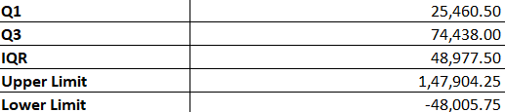
Insights
Finding Outliers
Outliers Values

Slide 6
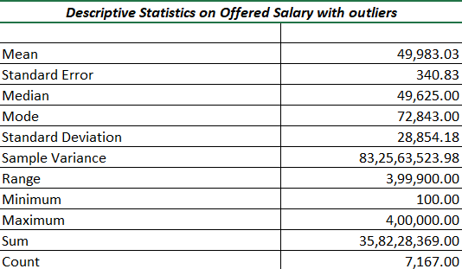
EDA with Outliers

Slide 7
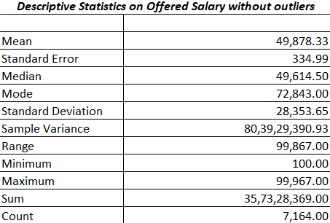
EDA without Outliers

Slide 8

Found one Missing value

Slide 9

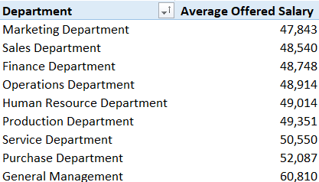
Q1. How many males and females are hired ?
Q2. What is average salary offered in this company ?

Slide 10
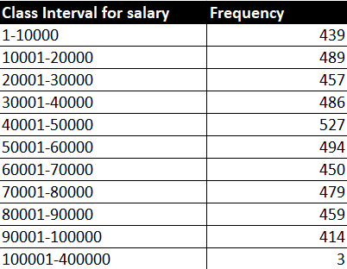
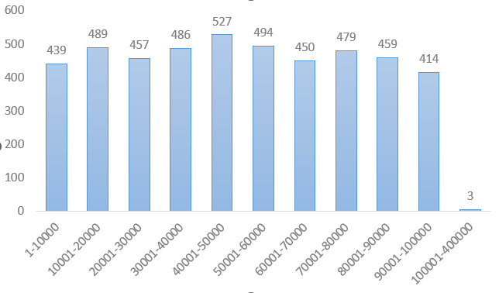
Q3. Draw the class intervals for salary in the company ?
Most employees fall under salary slab of 40001-50000.

Slide 11
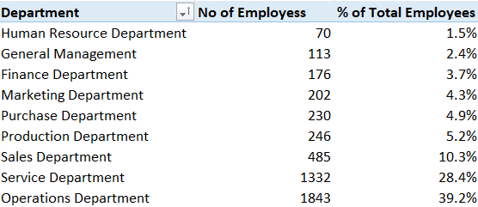
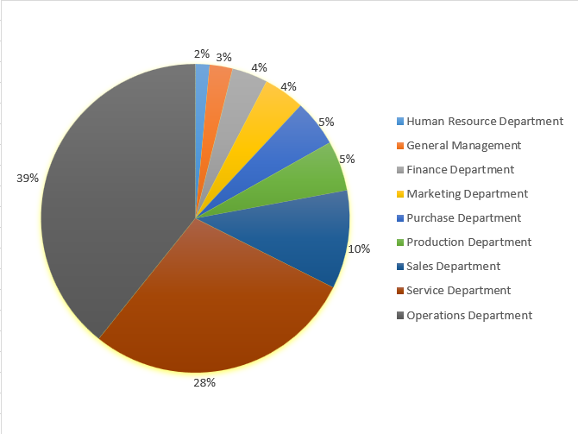
Q4. Draw Pie Chart / Bar Graph ( or any other graph ) to show proportion of people working different department ?
Majority of employees works in Service
And Operations dept.

Slide 12
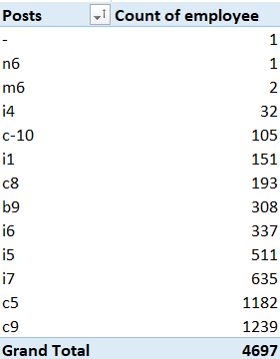
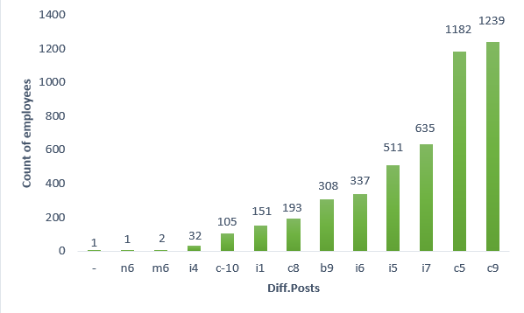
Q5. Represent different post tiers using chart/graph ?
Most of the employees works at the designation of c5 and c9.

Slide 13
result
By completing this project enhanced my understanding and practical skills in utilizing Excel formulas to derive valuable insights.
This project helped me to gain knowledge of how to use different type of charts to visualize your valuable insights for the understanding of other people.

